Slide 1
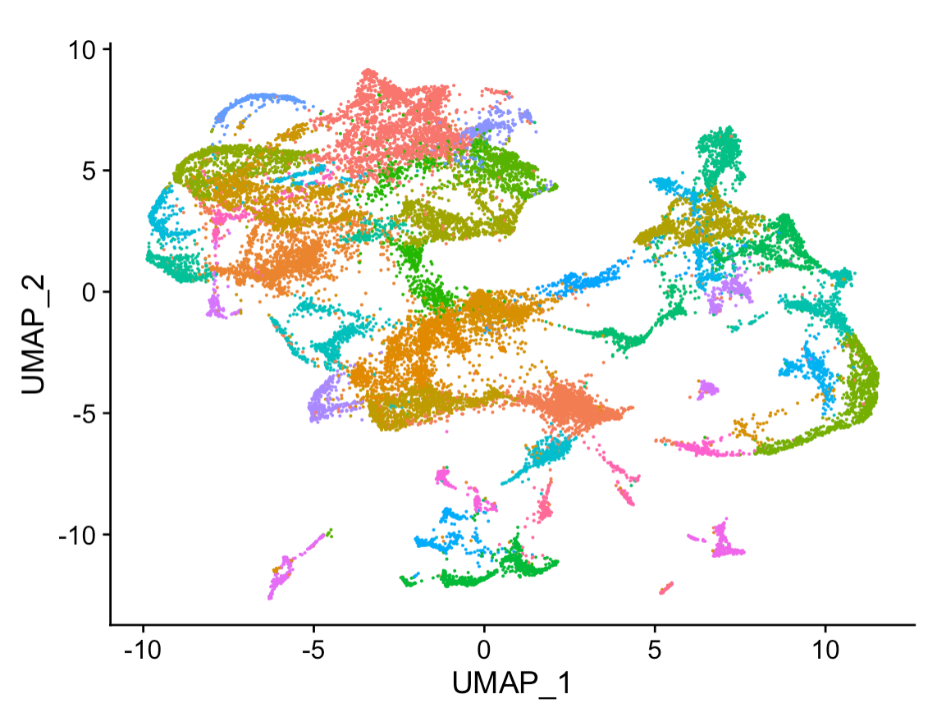
Un-supervised Deep Learning Data4ML

Slide 2
Reminder Dimensionality Reduction
Picture of a Line (500x500 pixels=250,000 Numbers)
Equation: y=m*x+b (2 numbers)
Both have the same information in different formats
It’s often a lot easier to analyze 2 number than 250,000

Slide 3
A Reminder
PCA
Linear algorithm that finds the directions with the largest variance
You can trust inter and intra cluster distances
You may have more important PCA components than you want to plot
Lossless until you discard higher PC dimensions
TSNE/UMAP
Relies on nearest-neighbors information
You can not trust inter and intra cluster distances
You can pick the dimension size you want to reduce to use
What if you want to get the best of both worlds
What if you want to use un-structured data

Slide 4
Deep Unsupervised Learning Vocab
Deep learning uses stack of layers to approximate a function. In unsupervised learning that function is a mapping from your input data to a latent space
Latent space – often denoted z (like x denotes inputs), think of this like your principal components or outputs of UMAP it’s then transformed space that normally has a lower dimension than the original.
Encoder – A function that maps x -> z it ‘encodes’ your input data
Decoder – A function that maps z -> x it ‘decodes’ your input data
Algorithms may use some variations one or all of these

Slide 5
Autoencoder
A common deep learning model for dimensionality reduction
Input
Reconstruction
Encoder
Decoder
Z
Trained to find the best way to ‘compress’ all the information into z possible to recreate the original data
The encoder preforms some dimensionality reduction, and the decoder tries to reverse this process

Slide 6
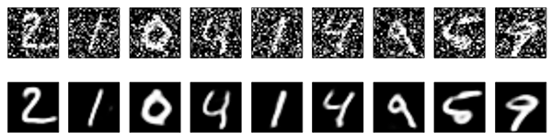
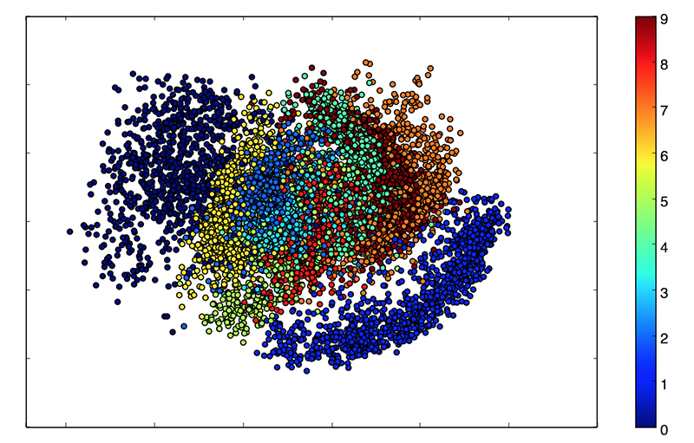
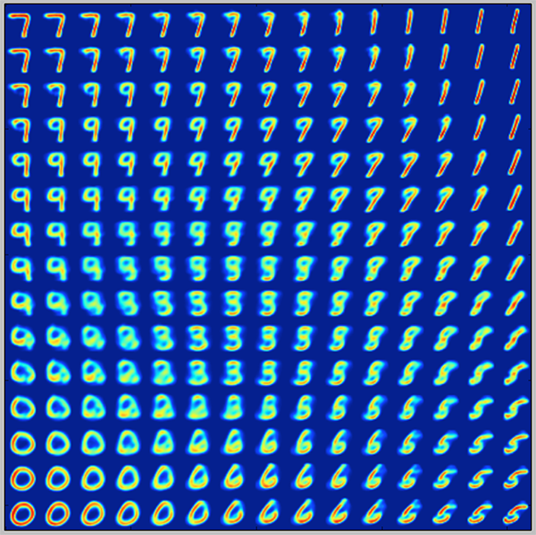
Encoder
Decoder
Latent Space
https://blog.keras.io/building-autoencoders-in-keras.html

Slide 7
Denoising
Another handy feature of Autoencoders is their ability to denoise
Noisy
Reconstructed
True

Slide 8
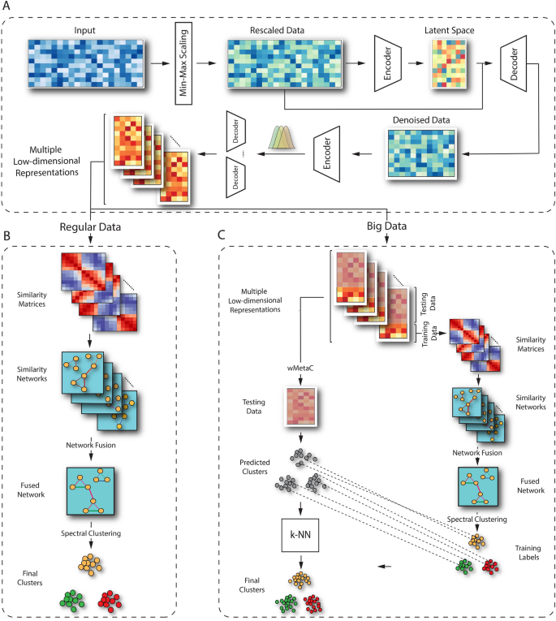
Becoming Available as Tools in Genomics
https://www.nature.com/articles/s41598-022-14218-6
scCAN: single-cell clustering using autoencoder and network fusion
Lots of exploration in this space, so there are lots of new algorithms to try, this one has a convenient R package

Slide 9
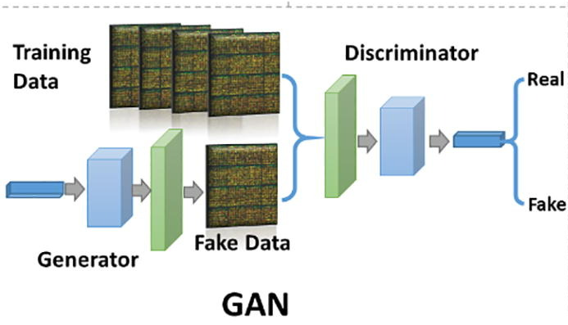
Generative Adversarial Learning (GANS)
A different model with only a generator, its goal is to generate new examples that have the same properties as your data.
Usually Better reconstructions that auto-encoders
Usually worse latent spaces
Application lean toward generating new examples
Therapeutic Proteins
Genomes
Etc.
Example https://thisstartupdoesnotexist.com/
https://www.sciencedirect.com/science/article/pii/S2001037020303068

Slide 10
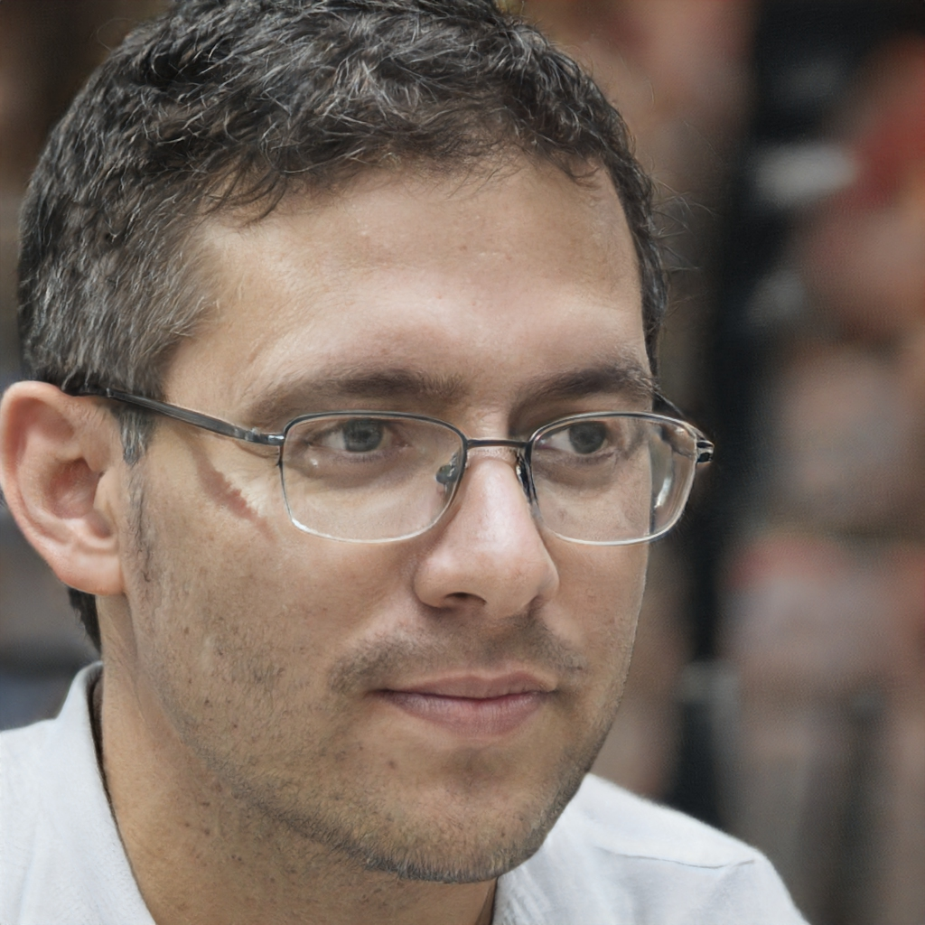
These Networks have produced incredible results for images
https://thispersondoesnotexist.com/

Slide 11
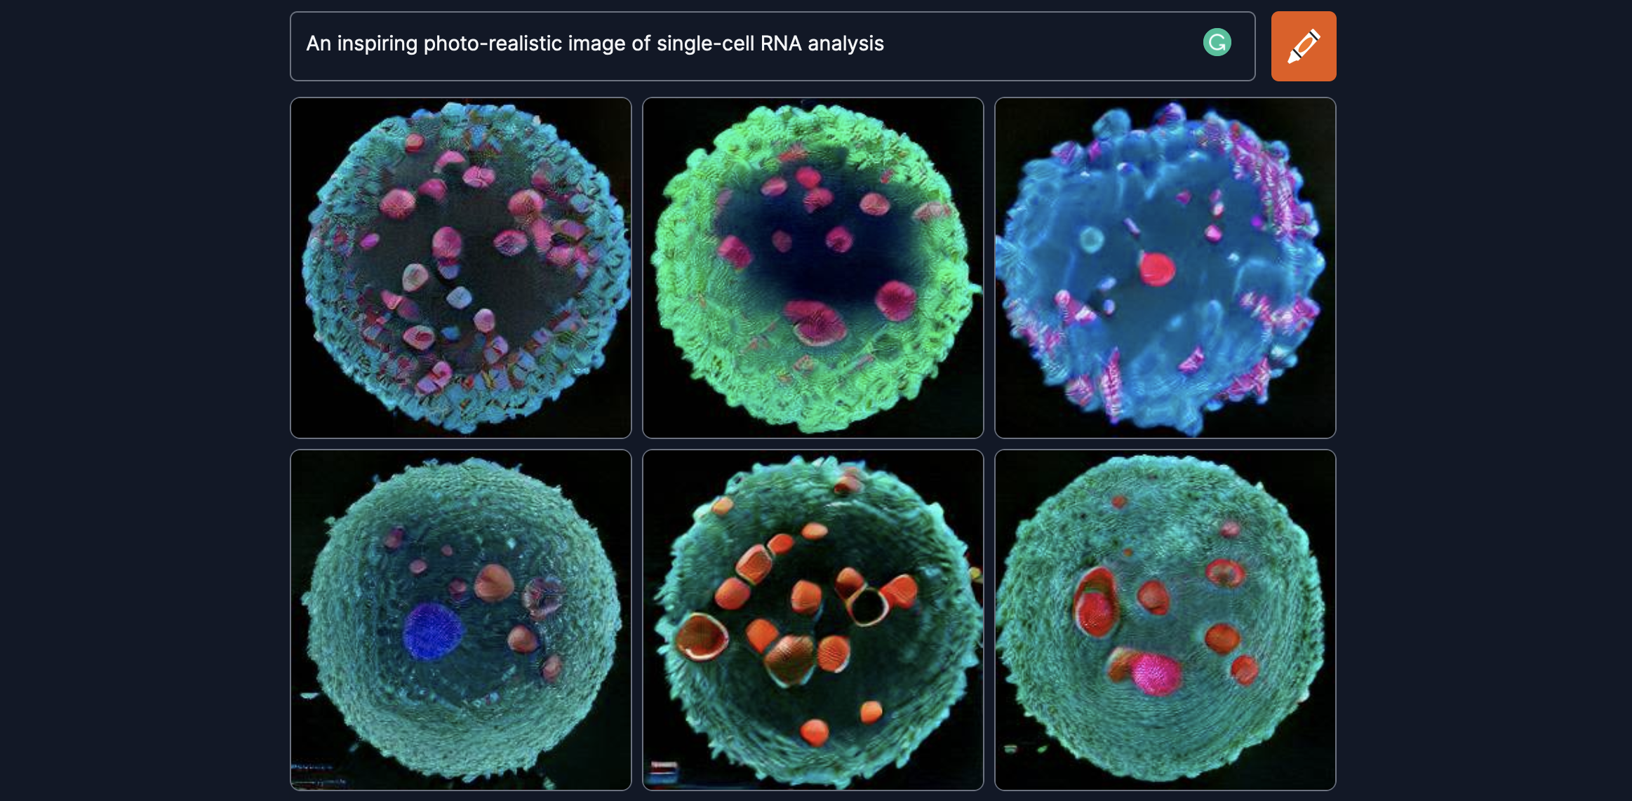
https://www.craiyon.com/

Slide 12
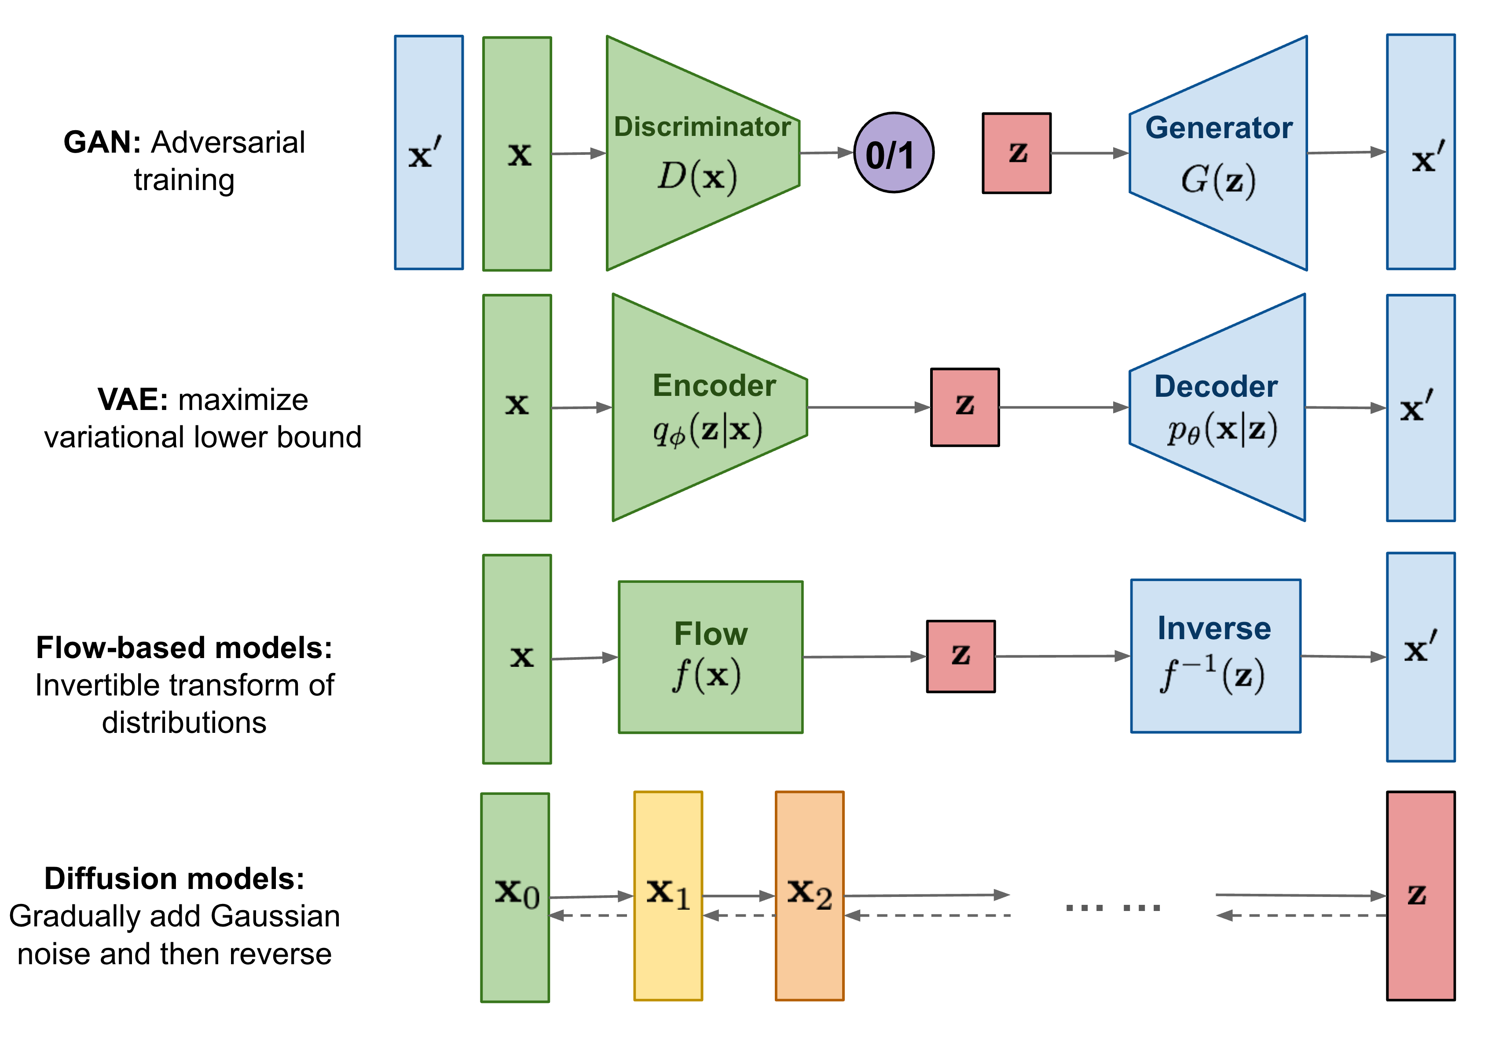
Other Models
https://lilianweng.github.io/posts/2021-07-11-diffusion-models/

Slide 13
Conclusions
Lots of interesting capabilities coming out of deep learning
Exactly how this will impact genomics is being figured out as we speak
Keep an eye out and try new methods as they come out

